Slide 1
Popular Programming Tech
Part 5
Composites Types

Slide 2
Learning Objective
LO 2 : Apply GO programming language techniques and libraries

Slide 3
Outline
Arrays
Slices
Maps
Structs
JSON
Text and HTML templates

Slide 4

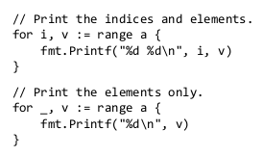
Arrays
An array is a fixed-length sequence of zero or more elements of a particular type.
Because of their fixed length, arrays are rarely used directly in Go
Individual array elements are accessed with the conventional subscript notation, where subscripts run from zero to one less than the array length

Slide 5

Arrays
By default, the elements of a new array variable are initially set to the zero value for the element type, which is 0 for numbers. We can use an array literal to initialize an array with a list of values:

Slide 6
Slices
Slices represent variable-length sequences whose elements all have the same type.
A slice type is written []T, where the elements have type T; it looks like an array type without a size.
Arrays and slices are intimately connected. A slice is a lightweight data structure that gives access to a subsequence (or perhaps all) of the elements of an array, which is known as the slice’s underlying array
A slice has three components: a pointer, a length, and a capacity
The pointer points to the first element of the array that is reachable through the slice, which is not necessarily the array’s first element
The length is the number of slice elements; it can’t exceed the capacity, which is usually the number of elements between the start of the slice and the end of the underlying array

Slide 7
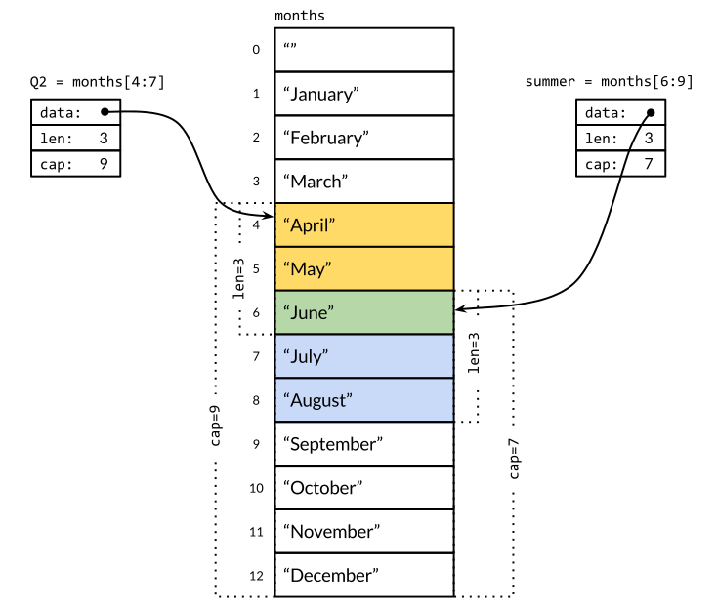
Slice
Multiple slices can share the same underlying array and may refer to overlapping parts of that array

Slide 8

so January is months[1] and December is months[12]. Ordinarily, the array element at index 0 would contain the first value, but because months are always numbered from 1, we can leave it out of the declaration and it will be initialized to an empty string

Slide 9
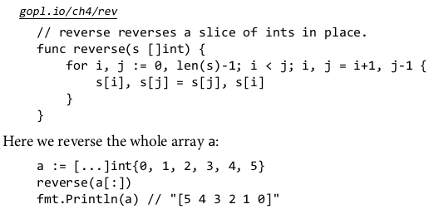
Slice
Since a slice contains a pointer to an element of an array, passing a slice to a function permits the function to modify the underlying array elements
In other words, copying a slice creates an alias (§2.3.2) for the underlying array

Slide 10
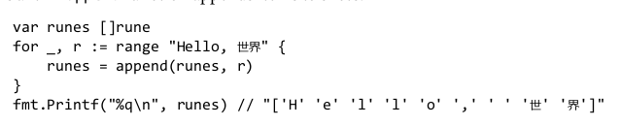
Append Function

Slide 11
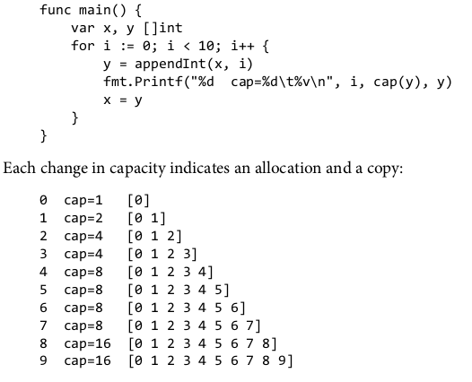

Slide 12
Maps
The hash table is one of the most ingenious and versatile of all data structures
In Go, a map is a reference to a hash table, and a map type is written map[K]V, where K and V are the types of its keys and values.
All of the keys in a given map are of the same type, and all of the values are of the same type, but the keys need not be of the same type as the values.

Slide 13
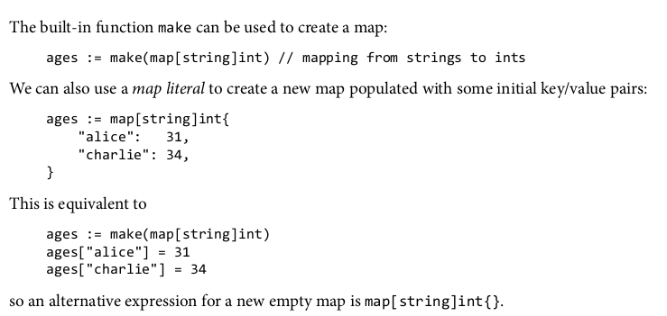

Slide 14
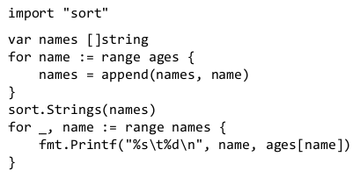
The order of map iteration is unspecified, and different implementations might use a different hash function, leading to a different ordering

Slide 15
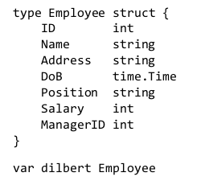
Structs
A struct is an aggregate data type that groups together zero or more named values of arbitrary types as a single entity

Slide 16
The individual fields of dilbert are accessed using dot notation like dilbert.Name and dilbert.DoB. Because dilbert is a variable, its fields are variables too, so we may assign to a field:

Slide 17
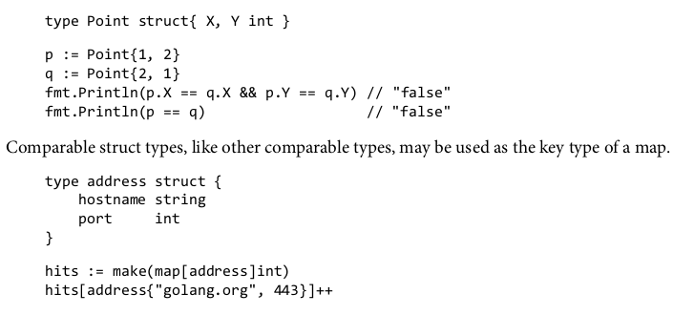
Comparing Struct
If all the fields of a struct are comparable, the struct itself is comparable, so two expressions of that type may be compared using == or !=

Slide 18
JSON
JavaScript Object Notation (JSON) is a standard notation for sending and receiving structured information
JSON is not the only such notation. XML (§7.14), ASN.1, and Google’s Protocol Buffers serve similar purposes and each has its niche, but because of its simplicity, readability, and universal support, JSON is the most widely used
Go has excellent support for encoding and decoding these formats, provided by the standard library packages encoding/json, encoding/xml, encoding/asn1, and so on, and these packages all have similar APIs.

Slide 19
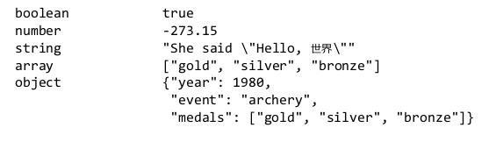
JSON is an encoding of JavaScript values—strings, numbers, booleans, arrays, and objects—as Unicode text
The basic JSON types are numbers (in decimal or scientific notation), booleans (true or false), and strings, which are sequences of Unicode code points enclosed in double quotes

Slide 20
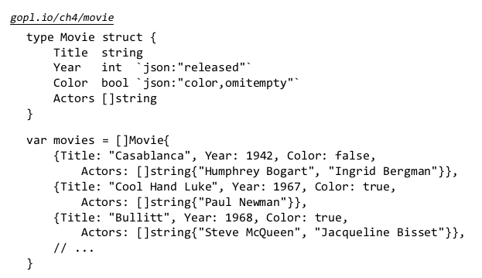

Slide 21
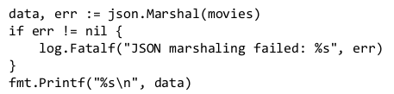
Data structures like this are an excellent fit for JSON, and it’s easy to convert in both directions
Converting a Go data structure like movies to JSON is called marshaling. Marshaling is done by json.Marshal

Slide 22

Marshal
Marshal produces a byte slice containing a ver y long string with no extraneous white space; we’ve folded the lines so it fits:

Slide 23
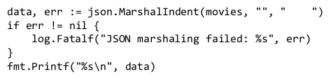
Marshalindent
This compact representation contains all the information but it’s hard to read. For human consumption, a variant called json.MarshalIndent produces neatly indented output. Two additional arguments define a prefix for each line of output and a string for each level of indentation:

Slide 24
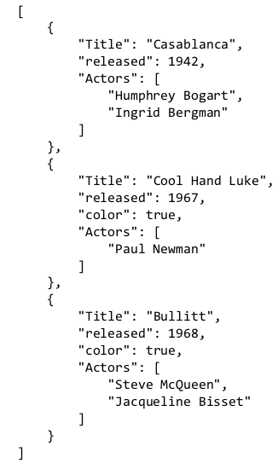

Slide 25
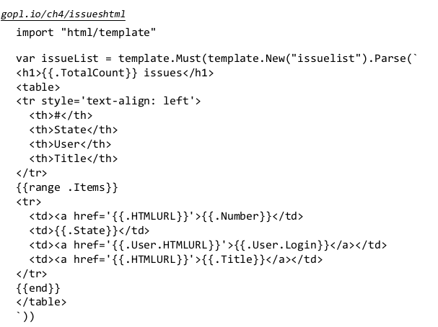
Text and HTML Templates

Slide 26
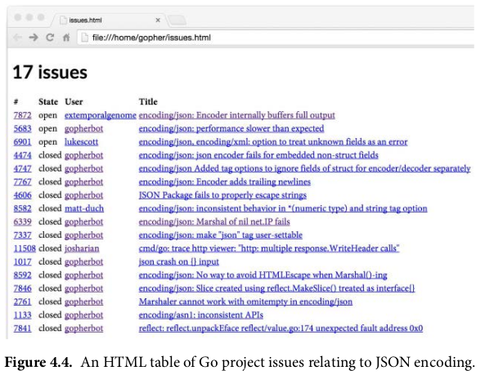

Slide 27
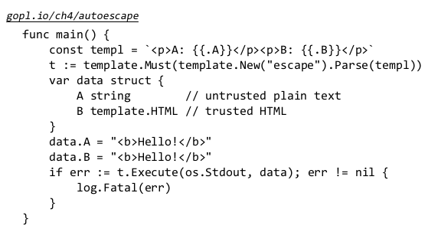

Slide 28
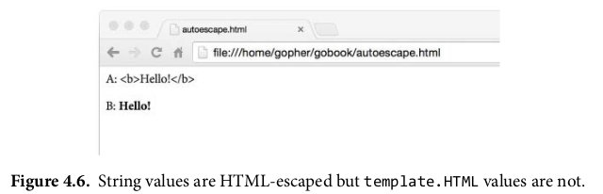

Slide 29
References
https://go.dev/doc/install
https://www.golangprograms.com/go-language/arrays.html
https://www.golangprograms.com/go-language/slices-in-golang-programming.html
https://www.golangprograms.com/go-language/golang-maps.html
https://www.golangprograms.com/go-language/struct.html

